Slide 1

INSY7315 · IMPLEMENTATION
Imizamo Yethu Aftercare Management System
Front end, back end, hosting and pipelines - built, live and ready for client approval.
Isabelle Devlin ST10445500 · Michaela Ferraris ST10325652 · Justin Fussell ST10280758· Thomas Pheiffer ST10068995· Nomsa Mkoka ST10301146
Notes:
Introduce the team and the client. Goal of today: show the working system and get approval to implement.

Slide 2





WHY WE'RE HERE
Purpose of this presentation
Demonstrate the functionality, design and implementation of the solution.
01
Front End
02
Back End
Key features and functionality
How we meet the requirements and NFRs
Technical decisions and challenges
Testing, pipelines and reliability
03
Hosting
04
GitHub / Pipelines
05
Features, Alignment & Demo

Slide 3
MARKING RUBRIC
55 marks
What we are marked on, and where we show it
Front End: Visual Design & Branding
10 marks
Front End: UX & Feedback
10 marks
Professional, polished interface with consistent colours, fonts and branding on every screen.
Intuitive navigation, clear affordance and consistent system feedback to user actions.
Shown in: Front End section
Shown in: Front End section
Technical Demo & Implementation
20 marks
Architecture & System Design
15 marks
Live, reliable demo of all key features, with the UI, logic and hosting working together.
Clear defence of the API, database, data flow, security and DevOps decisions.
Shown in: Hosting, Pipelines and Live Demo
Shown in: Back End and Pipelines
Rubric: INSY7315 Task 2, Code & Implementation and Presentation. Each box is ticked off after its section.

Slide 4




SYSTEM AT A GLANCE
One platform, four roles, one stack
Teacher
Manager
Admin
Parent / Guardian
CLIENT
STYLING
API
DATABASE
HOSTING
CODE + CI/CD
React + Vite
Tailwind CSS v4
Node.js + Express
PostgreSQL
Azure
GitHub
npm workspaces monorepo: /client and /server live in one repository.

Slide 5
ISABELLE
Development, Deployment, and Demonstration
My Contribution
Overall Responsibilities:
Hosting & Deployment
Azure App Service
Production deployment
Environment configuration
Database
PostgreSQL setup
Database configuration
Connection/deployment support
Documentation
Part 1 → Part 2 updates
Technical documentation
Implementation changes
Demonstration
Demo video editing
Final presentation preparation
📚 Documentation
☁️ Azure Deployment
Updating existing part 1 documentation to reflect any changes during development.
Deploying the WebApp through Azure App Service.
🗄️ Database Creation + Support
🎥 Demo Video
Assisting with the PostgreSQL Database configuration after moving from Azure SQL Database.
Final presentation preparation as well as video editing.

Slide 6





HOSTING
Deployed architecture on Azure
HTTPS
HTTPS /api
TLS · private
Users
React client
Express API
PostgreSQL
Any browser
Azure web app
Azure App Service
Azure Database
Application hosted
Database hosted
APIs hosted
Stable & responsive
Client served over HTTPS at a public URL
Managed PostgreSQL, connected via env config
Express API on App Service, reached at /api
/api/health check, logging, fail-fast env validation

Slide 7
ISABELLE
Azure Hosting + Deployment
My Responsibilities:
Created/configured Azure hosting environment
Connected project for deployment
Configured application settings
Deployed the web application
Troubleshot deployment and runtime issues
Verified the live application
Development
↓
GitHub Repository
↓
Azure App Service
↓
Live Web Application

Slide 8
ISABELLE
PostgreSQL
My Responsibilities:
Database setup and configuration
Schema implementation
Azure/database connectivity
Environment variables
Connection troubleshooting
React Frontend
↓
Node.js + Express
↓
PostgreSQL
↑
Azure Hosting

Slide 9

01
Front End
Look, feel, usability and the experience of every role using the system.

Slide 10



FRONT END
Front End – Justin Fussell
My Part
What I was assigned
What I built
Justin Fussell, ST10280758
Assigned the front end
This is the section I am presenting
Look, feel and branding
Teacher, Manager, Admin and Parent screens
Phone, iPad and desktop behavior
React and Vite client
Shared cards, buttons and navigation
The screenshots in this section

Slide 11
FRONT END
Look & feel, branding, colour & typography
Look and Feel
Branding
Colour & Typography
Calm, friendly aesthetic suited to a children's aftercare centre
Clear visual hierarchy: page title → key actions → data
Same card, table and form styling on every screen
Imizamo Yethu logo in the header of every screen
Brand colours defined once as Tailwind theme tokens
Consistent brand voice in labels and messages
Orange primary, cream background, yellow on learner profiles
Same header, cards and buttons on every screen
Clear title, then actions, then the data

Slide 12
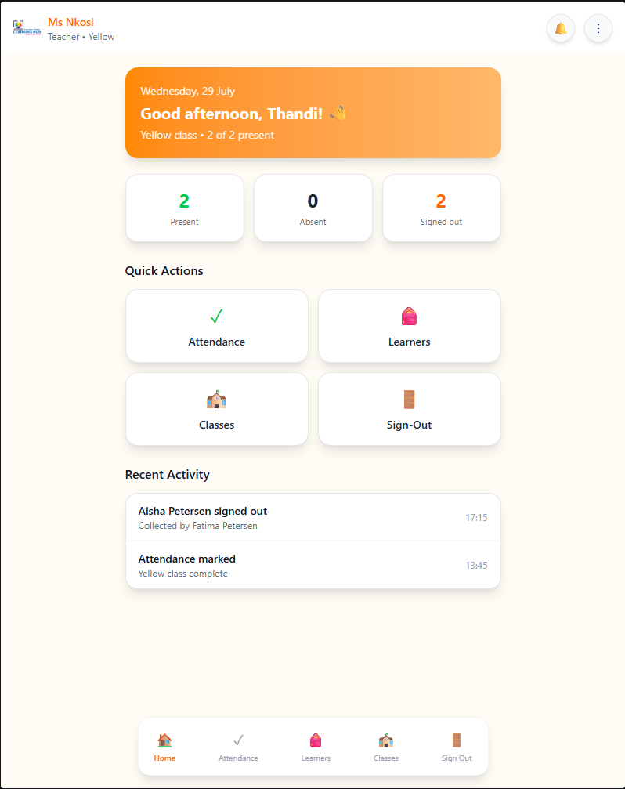



FRONT END
Usability, affordance & consistency
Usability
Role-based navigation shows each user only what they need. Related actions are grouped (e.g. attendance + sign-out on one learner view).
Affordance
Buttons are filled with hover/focus states; links are underlined; destructive actions are coral and ask to confirm.
Consistency
Shared React components (buttons, inputs, modals, tables) so layout and interactions behave the same everywhere.

Slide 13




FRONT END
Responsive design & accessibility
Responsive Design
Accessibility
Semantic HTML with labelled form fields for screen readers
Full keyboard navigation with visible focus rings
Colour contrast checked; colour never the only signal
Text sized in rem so it scales with browser zoom
Alt text on images and aria-labels on icon buttons
Mobile
Tablet
Desktop
< 640px
md 768px
lg 1024px+
Stacked cards, bottom nav stays
Two-column layouts
Wider layout, full tables

Slide 14





FRONT END
Feedback, system response & performance
Feedback and System Response
Performance
Loading
Success
Vite production build: minified and tree-shaken
Tailwind v4 only ships the classes we use
Lightweight icons, no heavy UI frameworks
API returns only the columns a screen needs
Spinners and disabled buttons while requests run
A banner confirms a save, e.g. learner details saved
Error
Confirm
Plain-language errors from the API, shown inline
Dialog before deleting or signing out a learner

Slide 15
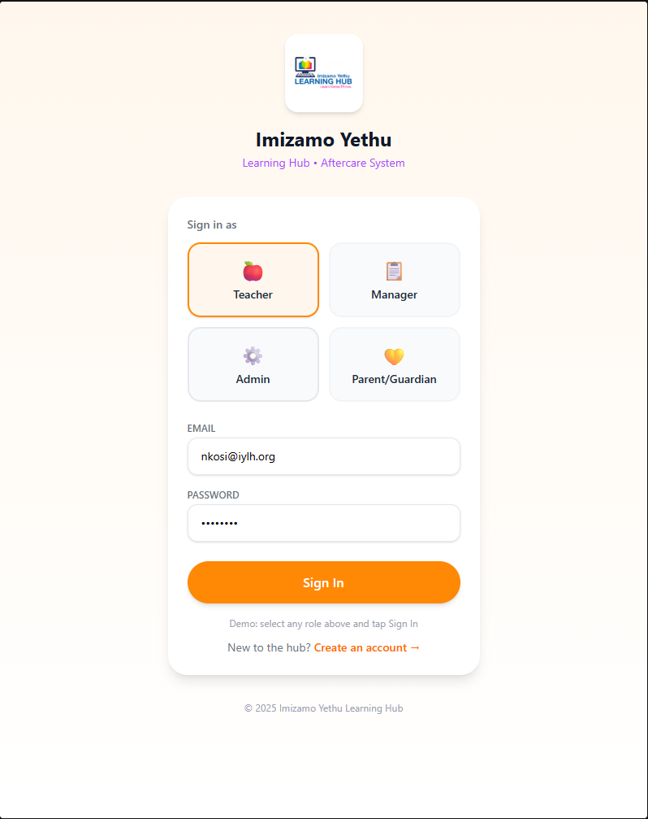
FRONT END
Four roles, one screen
On this screen
Four role cards, the hub logo, email and password.
What to say
Pick Teacher, Manager, Admin or Parent, then Sign In.
Why it matters
One app. After sign-in, each role sees only its own pages.

Slide 16
Teacher
FRONT END
Only what a teacher needs
On this screen
Ms Nkosi, Yellow class, and today's present, absent and signed-out counts.
What to say
Open Attendance, Learners, Classes or Sign-Out from a card or the bottom nav.
Why it matters
The teacher starts from today's class, not from a settings menu.

Slide 17
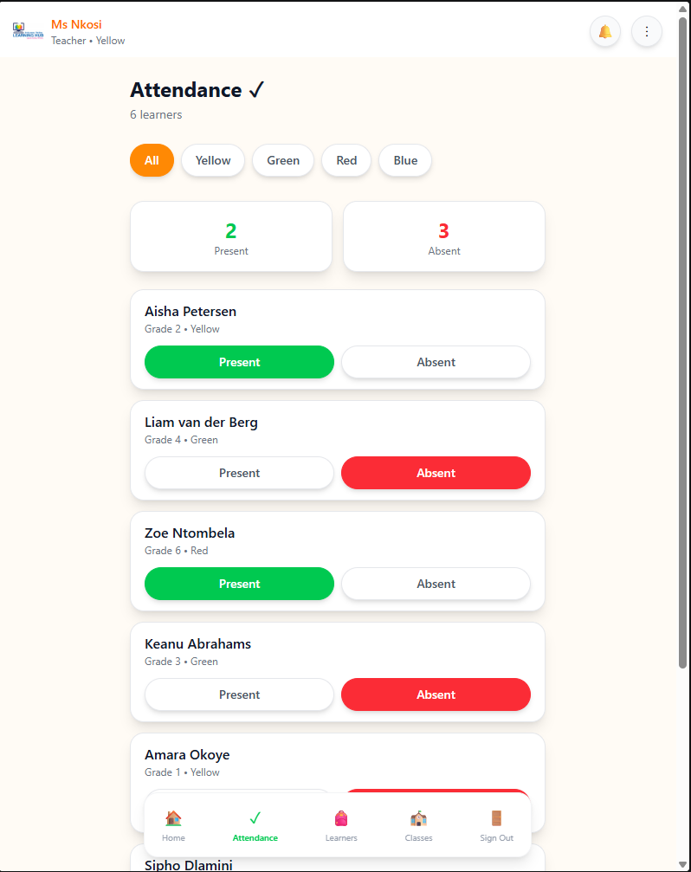
FRONT END
Mark the class
On this screen
Class filters, and Present or Absent on each learner.
What to say
Filter by Yellow, Green, Red, Blue or Orange then mark the row.
Why it matters
The counts at the top change as the teacher marks the class.

Slide 18
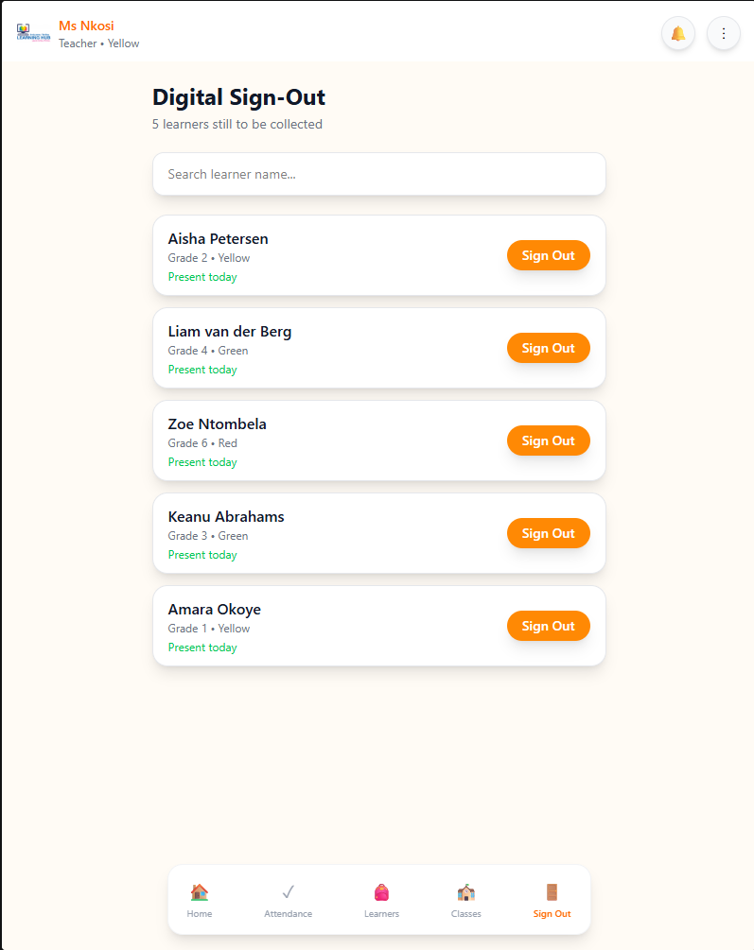
FRONT END
Who still needs collecting
On this screen
Learners still to be collected, with a search box.
What to say
Search a name, then tap Sign Out.
Why it matters
This opens the collector check. It does not sign the child out yet.

Slide 19
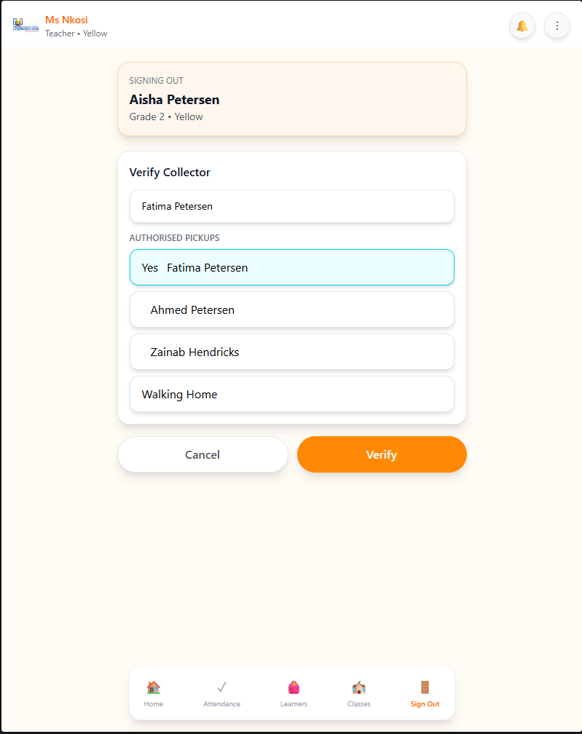
FRONT END
Authorised pickup
On this screen
Aisha, the typed name, and the authorised pickup list.
What to say
Select Fatima, Ahmed, Zainab or Walking Home, then Verify.
Why it matters
Only a listed collector completes the sign-out. Walking Home is flagged.

Slide 20
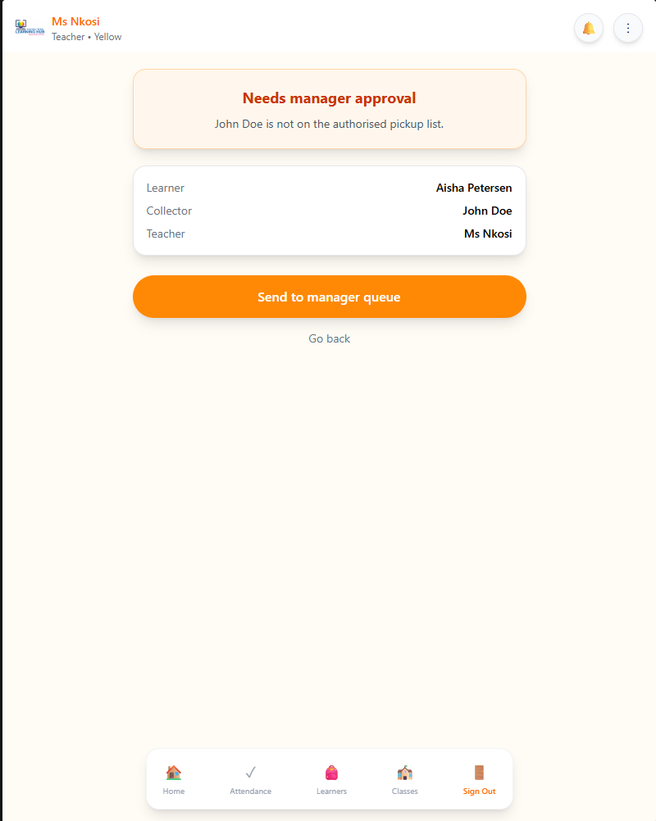
FRONT END
Unknown collector
On this screen
John Doe is not on the list. Learner, collector and teacher are shown.
What to say
Send it to the manager queue or go back.
Why it matters
The child is not signed out until a manager reviews it.

Slide 21
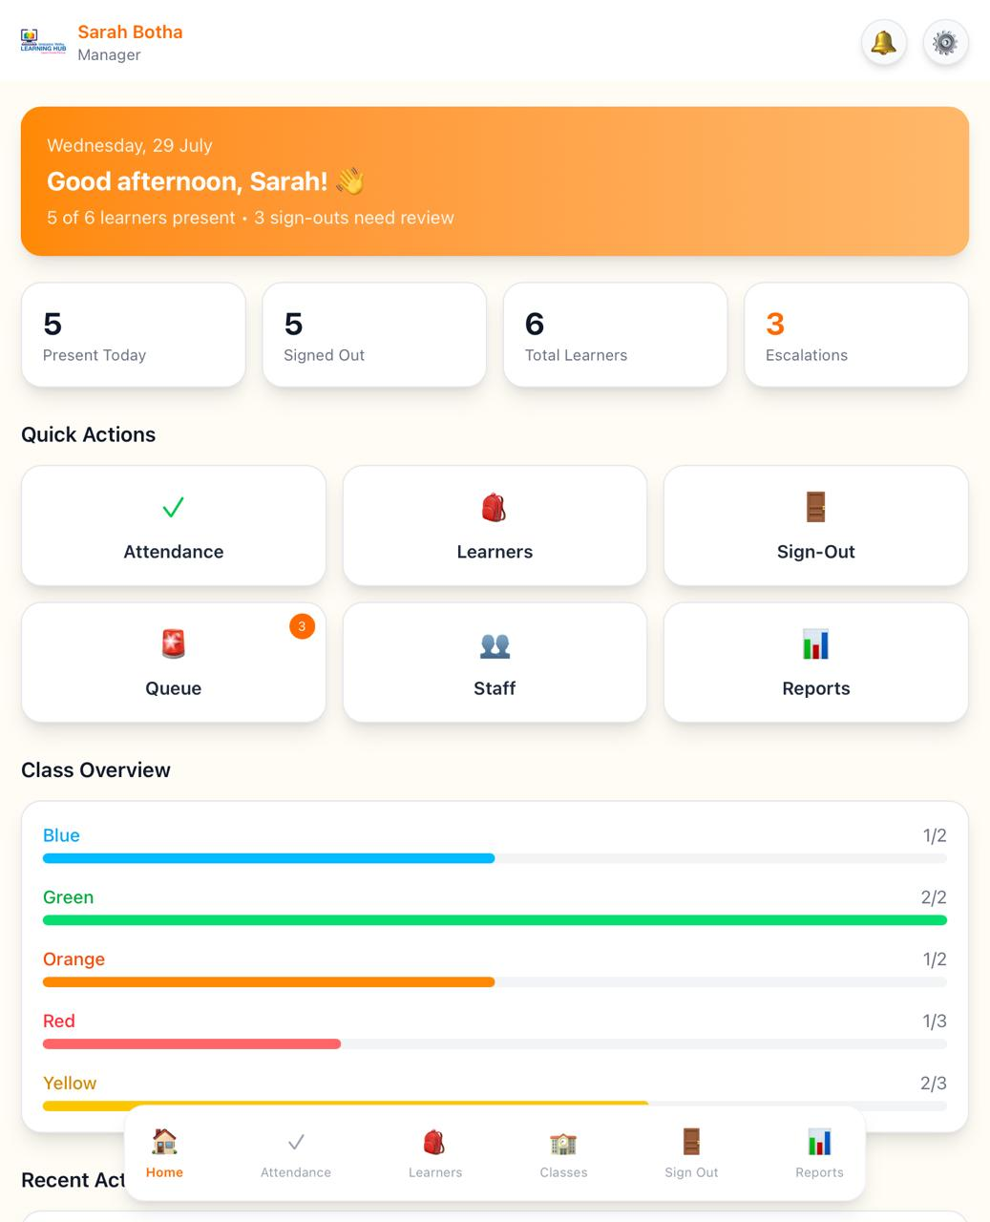
Manager
FRONT END
The whole centre
On this screen
Centre totals, a queue badge of 3, staff, reports and the settings gear.
What to say
Open the queue to review flagged sign-outs.
Why it matters
The manager sees every class, not only one.

Slide 22
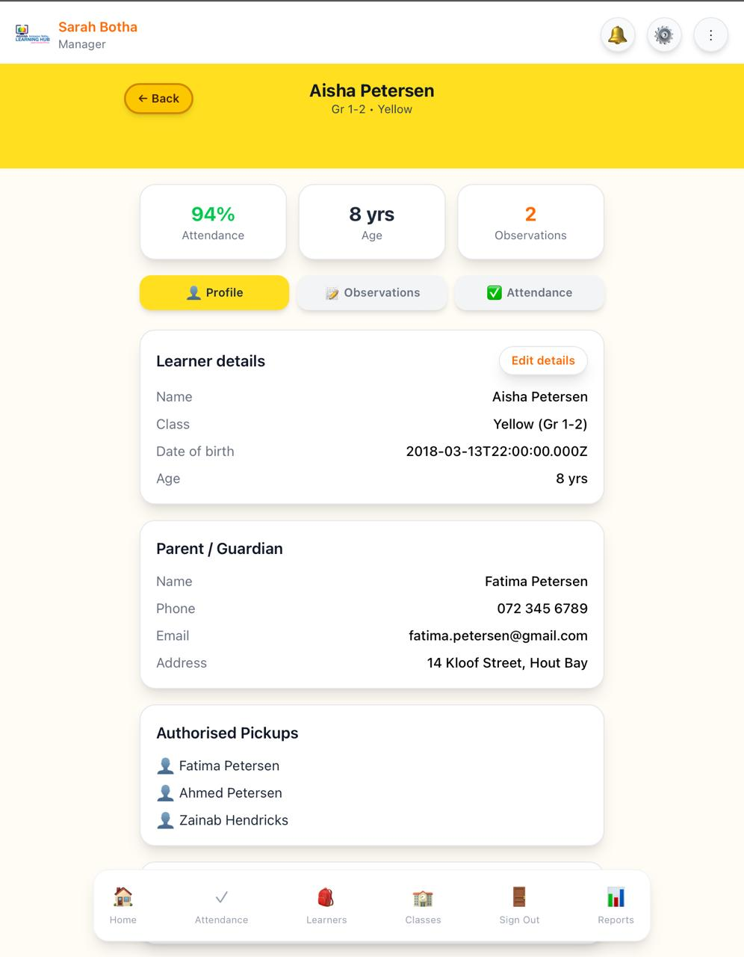
FRONT END
Manager can edit details
On this screen
Aisha's profile, with name and date of birth ready to edit.
What to say
Change the name or date of birth, then Save.
Why it matters
The header and the age update. A teacher can view this page, but cannot save.

Slide 23
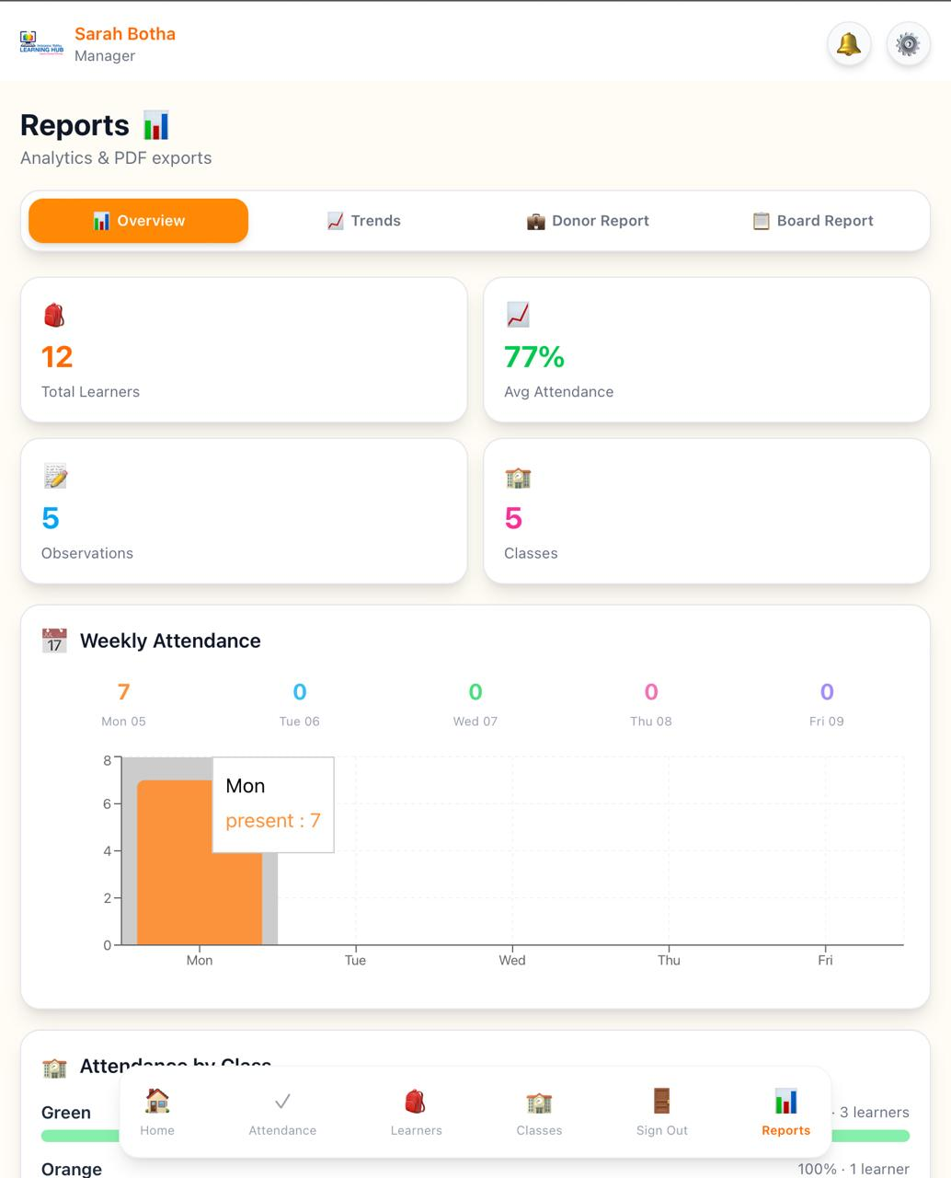
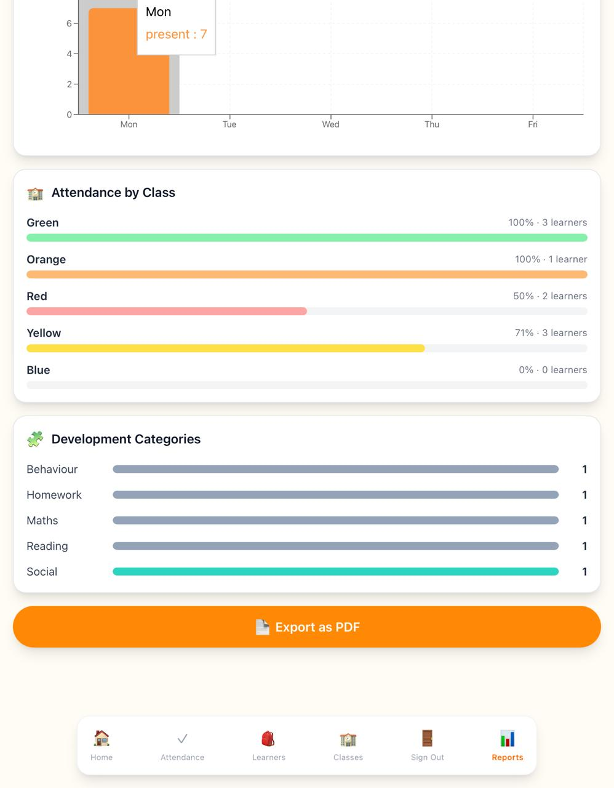
FRONT END
Week at a glance
On this screen
The weekly chart, 92% attendance, and Overview selected.
What to say
Switch to Trends, Donor or Board, or tap Export as PDF.
Why it matters
This is the week for the manager, not the daily register.

Slide 24
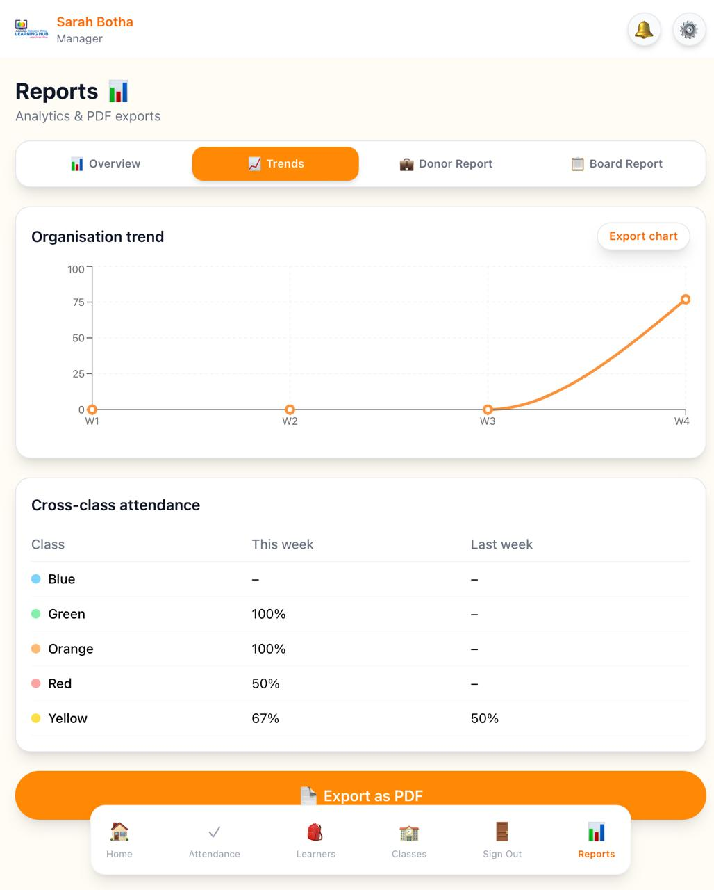
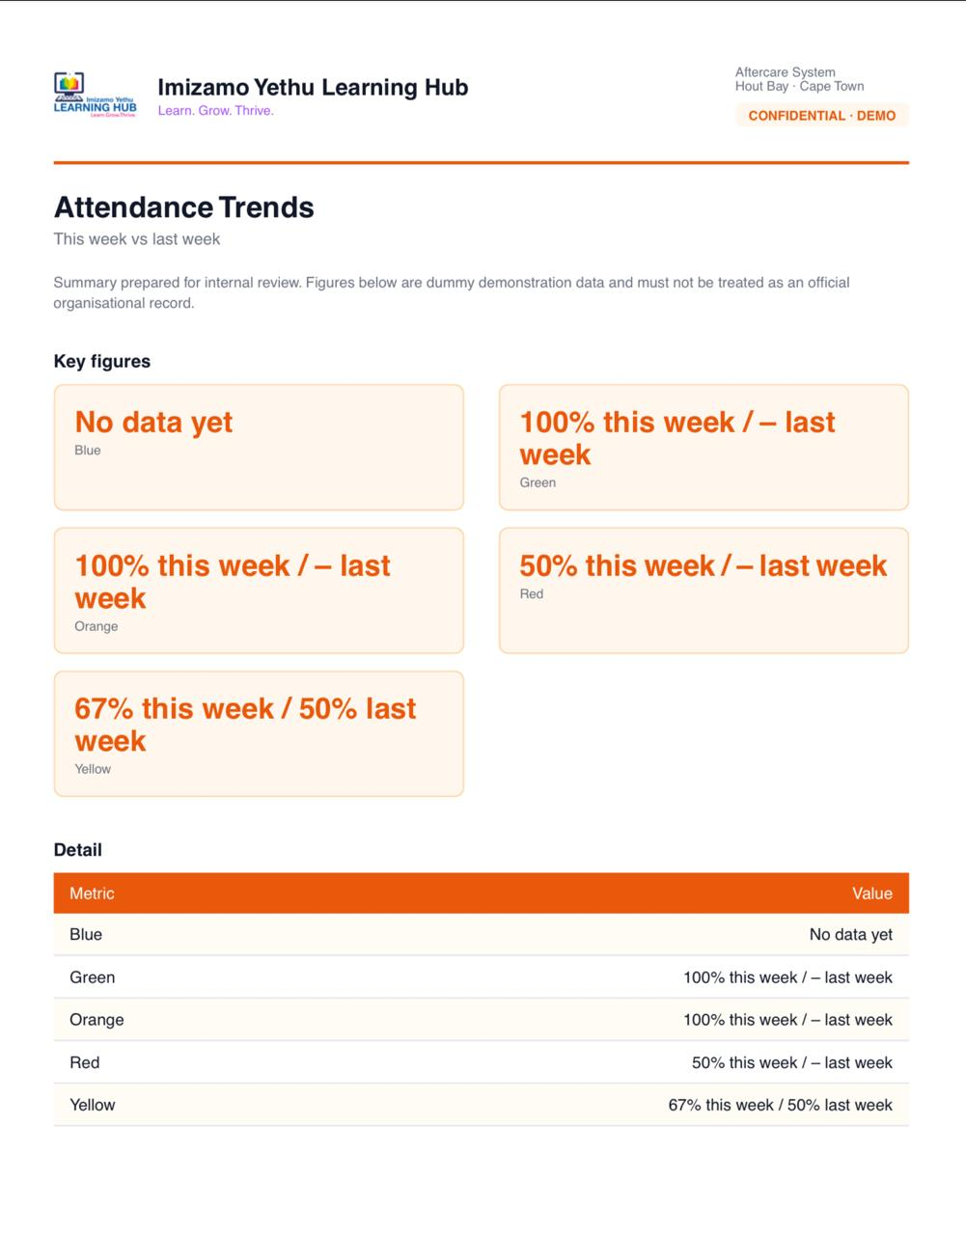
FRONT END
Week at a glance
On this screen
The weekly chart, 92% attendance, and Overview selected.
What to say
Switch to Trends, Donor or Board, or tap Export as PDF.
Why it matters
This is the week for the manager, not the daily register.

Slide 25
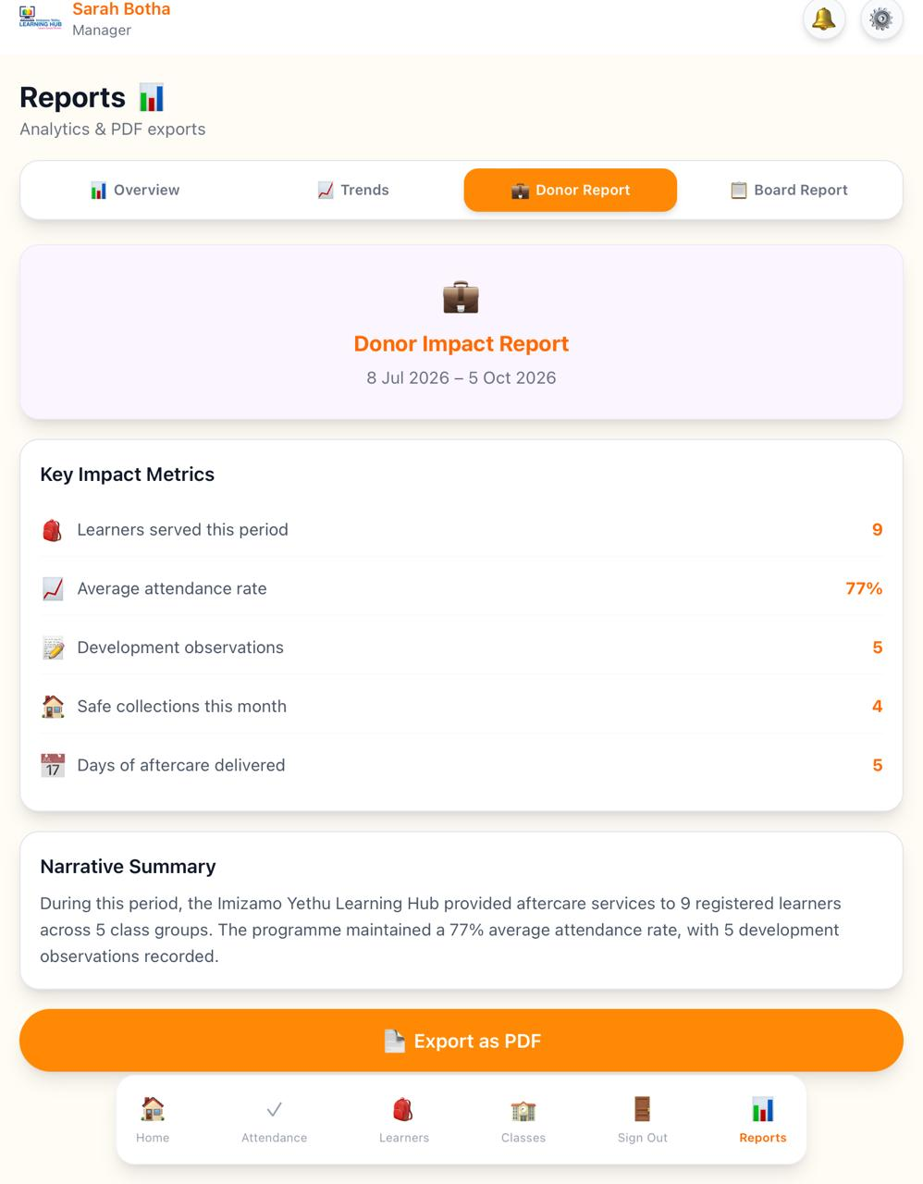
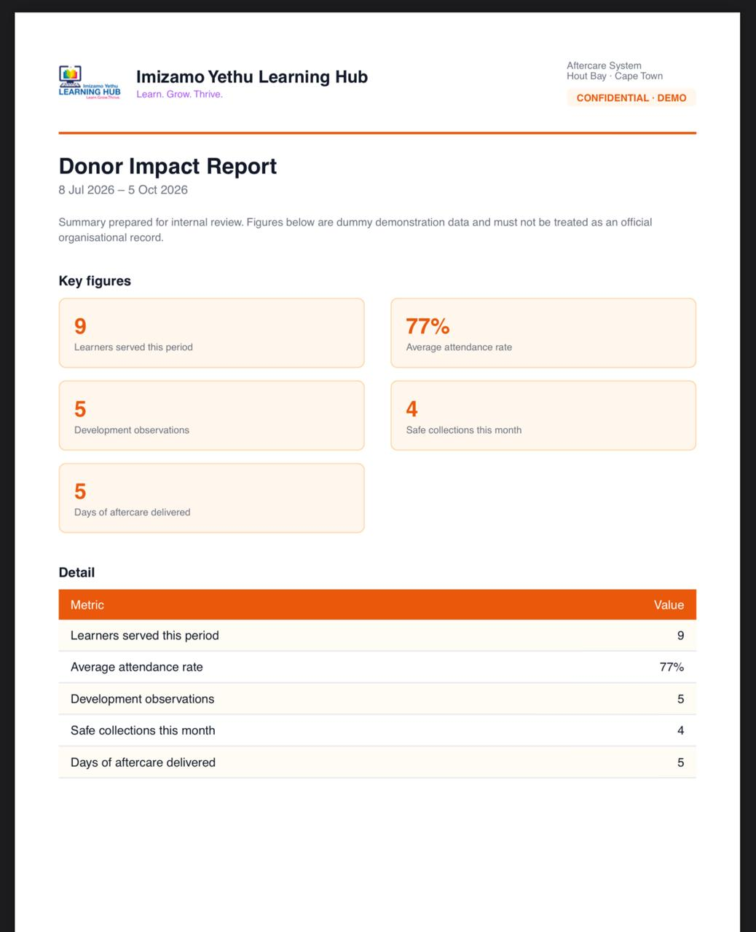
FRONT END
Week at a glance
On this screen
The weekly chart, 92% attendance, and Overview selected.
What to say
Switch to Trends, Donor or Board, or tap Export as PDF.
Why it matters
This is the week for the manager, not the daily register.

Slide 26
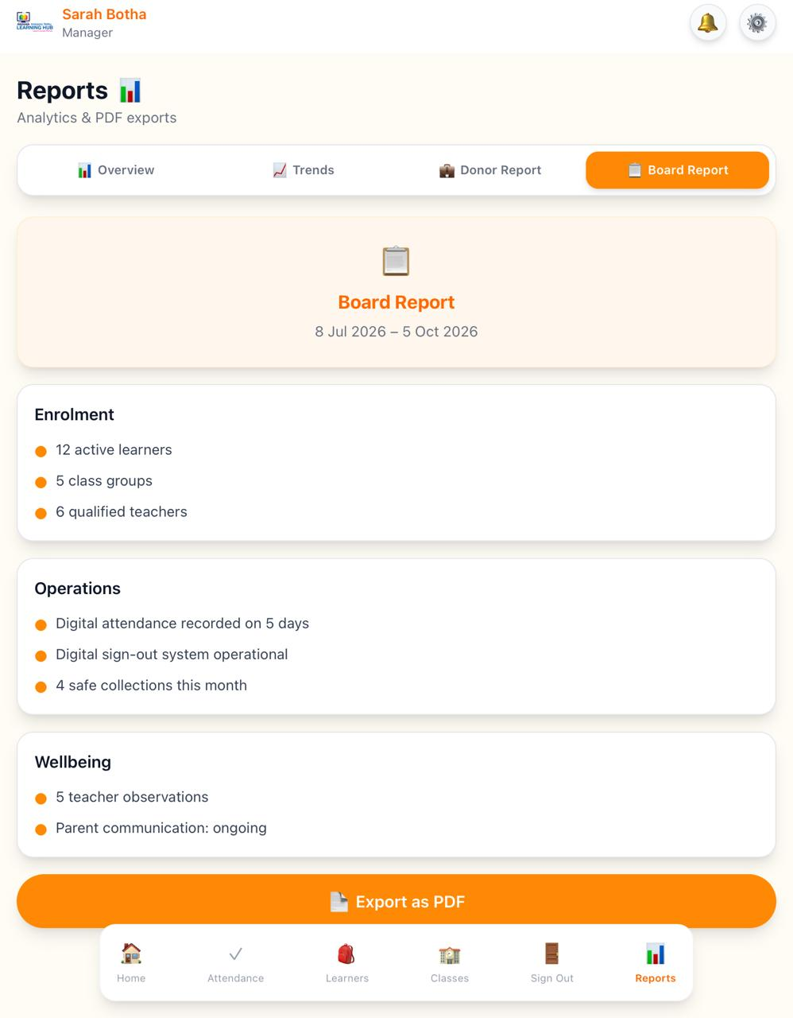
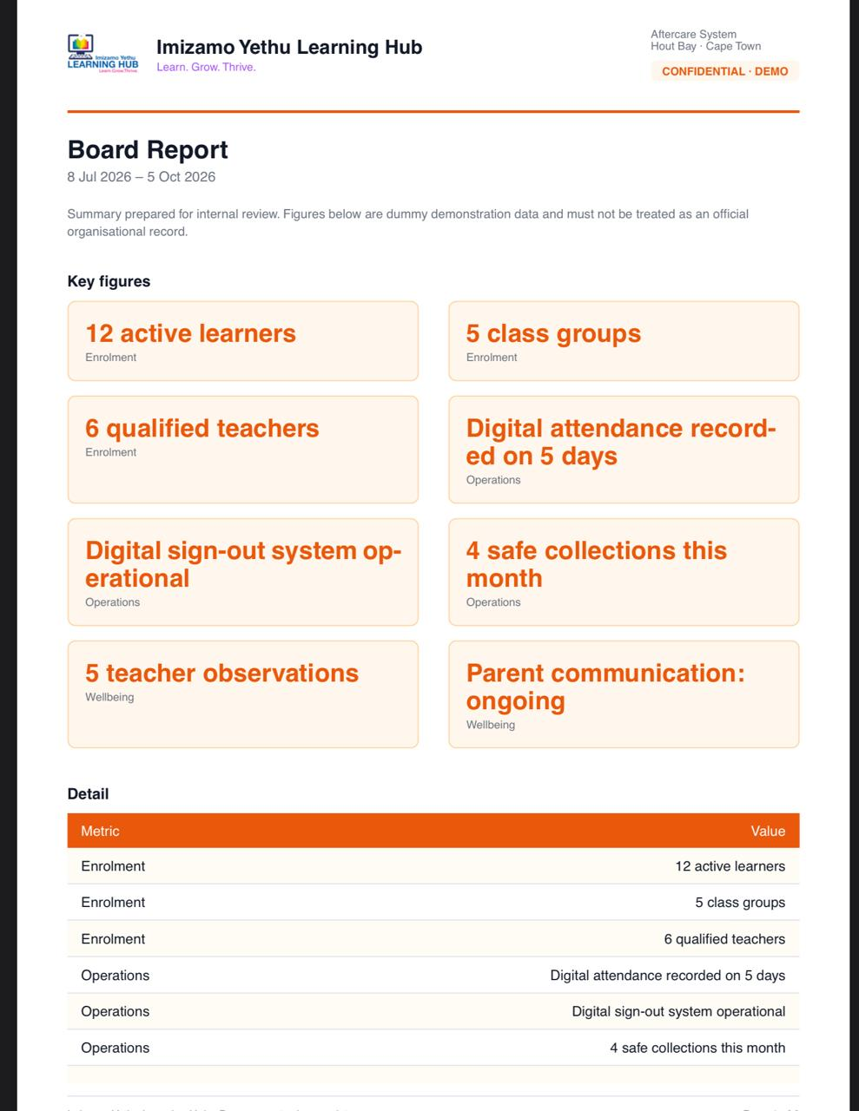
FRONT END
Week at a glance
On this screen
The weekly chart, 92% attendance, and Overview selected.
What to say
Switch to Trends, Donor or Board, or tap Export as PDF.
Why it matters
This is the week for the manager, not the daily register.

Slide 27
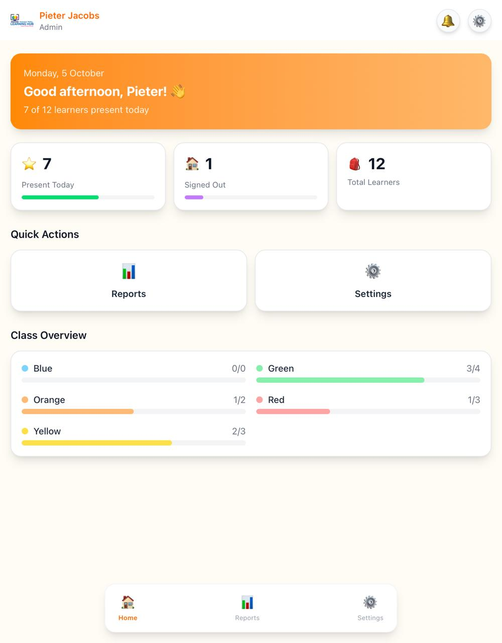
FRONT END
Admin home
On this screen
System Admin home, with reports, learners and attendance.
What to say
Open records from the cards, or settings from the gear.
Why it matters
Admin maintains records. They do not run the sign-out desk, or attendance process.

Slide 28
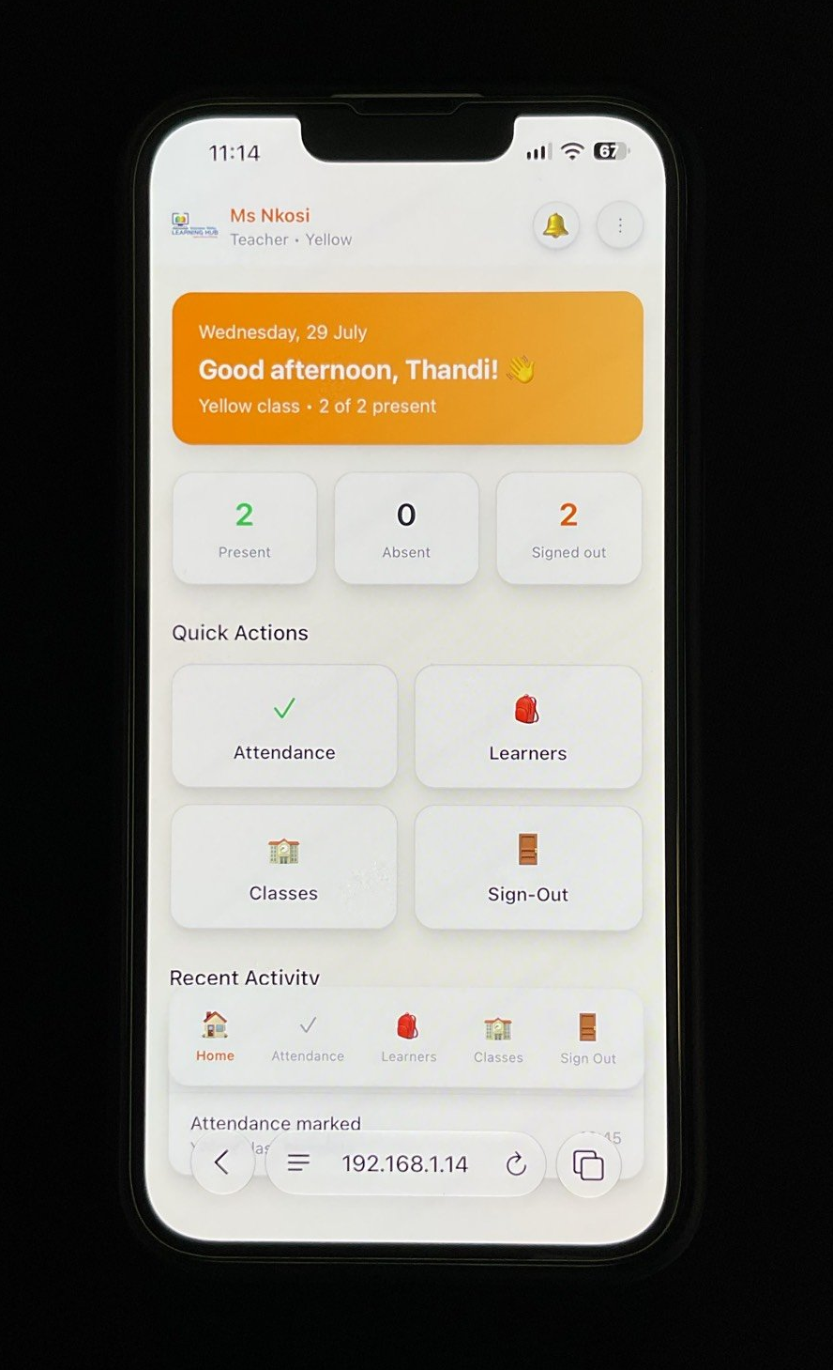
FRONT END
Teacher home on a phone
On this screen
The same teacher home, stacked on a phone, logo still in the header.
What to say
Move between pages with the bottom nav. It stays on the screen.
Why it matters
A teacher can run the day from a phone in the room.

Slide 29
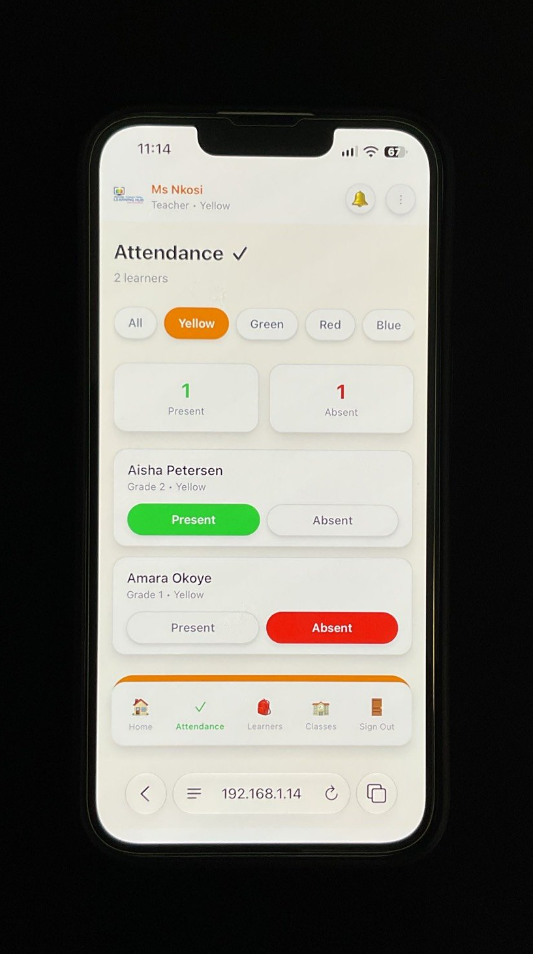
FRONT END
Attendance on a phone
On this screen
Yellow selected. Present and Absent stay large enough to tap.
What to say
Filter the class, then mark the learner. No side menu.
Why it matters
The daily job still fits on a phone.

Slide 30
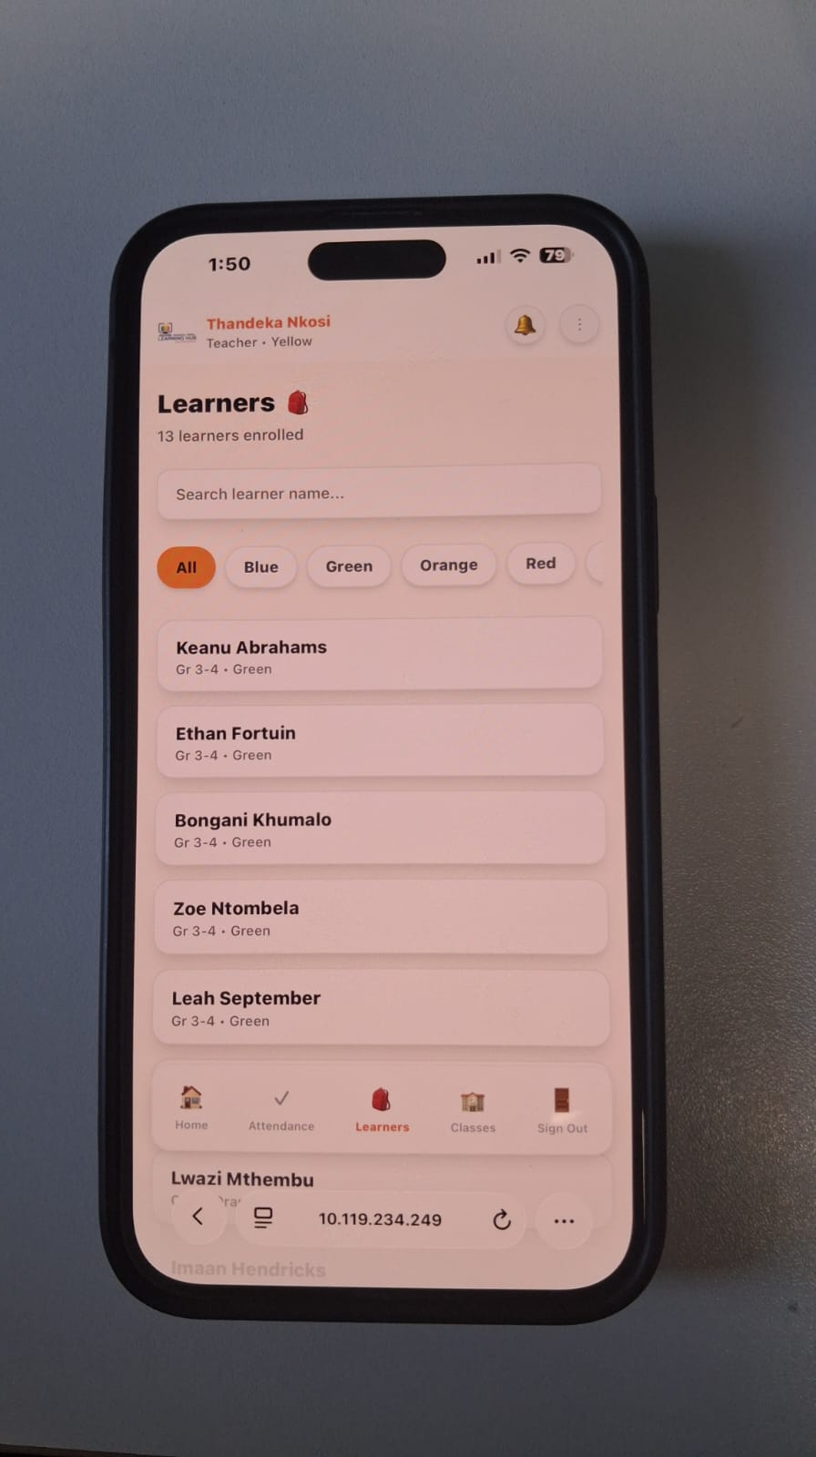
FRONT END
Learners on a phone
On this screen
All learners selected. Learner details display from each class.
What to say
Filter the class, to see all the learners.
Why it matters
The daily job still fits on a phone.

Slide 31
FRONT END
Classes on a phone
On this screen
Shows all classes.
What to say
Teacher sees how many learners are in each class.
Why it matters
The daily job still fits on a phone.

Slide 32
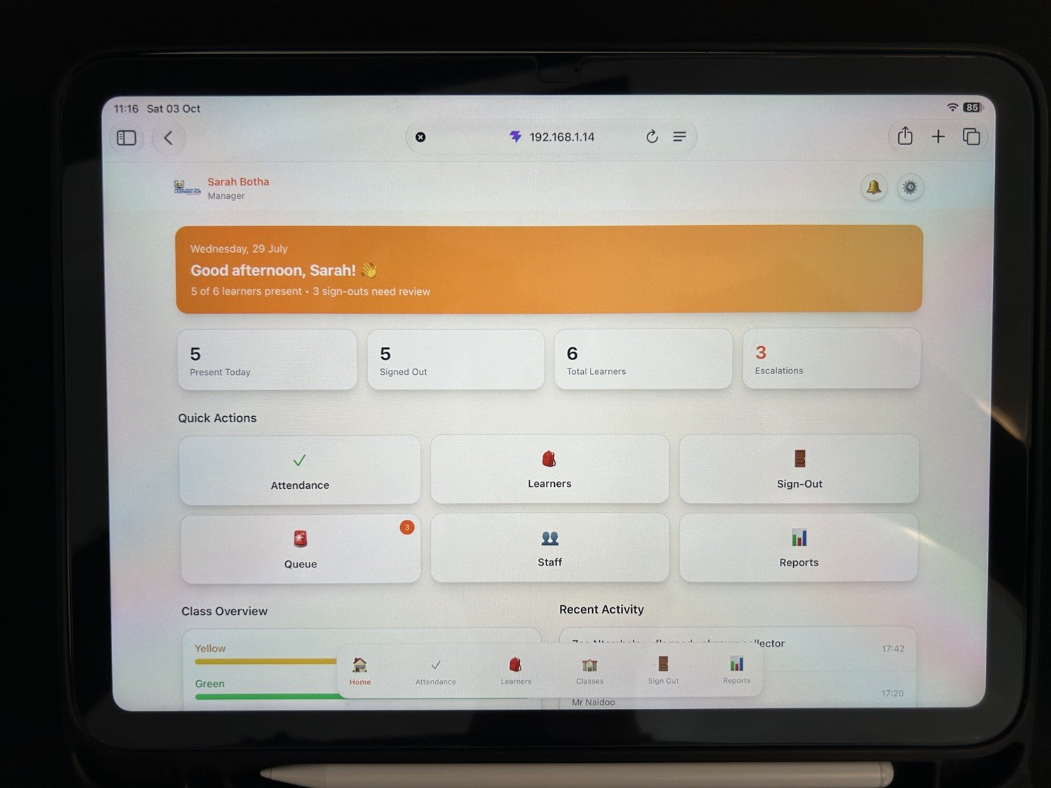
FRONT END
Manager home on an iPad
On this screen
The manager home, wider, with queue, staff and reports in a row.
What to say
Use it at a desk. The nav stays at the bottom.
Why it matters
Manager and Admin stay wide. They are not squeezed into the phone layout.

Slide 33
RUBRIC CHECK: FRONT END
20 marks
Front end: rubric ticked off
Visual Design & Branding
10 marks
UX & Feedback
10 marks
✓
Polished, professional interface
Calm, child-friendly look with clear hierarchy
✓
Intuitive navigation
Role-based menus and a bottom nav on every role
✓
Branding applied
Imizamo Yethu logo and orange and cream palette
✓
Clear affordance
Filled buttons, hover and focus states, coral for destructive actions
✓
Consistent fonts, colours, styling
Shared cards, buttons and tables, theme tokens set once
✓
System feedback on every action
Loading, success, error and confirm states
✓
Same identity on every screen
Teacher, Manager, Admin, Parent, phone and iPad
✓
Logical, user-centric flow
Mark class, sign out, verify collector, manager queue

Slide 34
02
Back End
Programming, database, APIs, security and the flow of data through every layer.

Slide 35
BACK END
Programming skills across three levels
LEVEL 3
LEVEL 2
Advanced
LEVEL 1
Intermediate
Basic
Design patterns: Repository, Singleton DB pool, Middleware chain
Postgres error-code mapping (23505, 23503) to HTTP responses
Optimised queries with explicit column lists
Modular layers: routes → controllers → services → repositories
Classes per repository (Learner, Attendance, User)
Centralised error-handling middleware
Control structures and loops for validation
Typed request data with clear defaults
Small, single-purpose helper functions

Slide 36
BACK END
Database integration - PostgreSQL
users
id · role · password_hash
Relational model fits our data: learners, guardians, attendance and sign-outs are tightly linked
Primary and foreign keys enforce relationships in the database itself
ON DELETE RESTRICT on sign-out records protects historical audit data
Unique constraints stop duplicate attendance for the same learner and day
Repository classes own all SQL, using parameterised queries
learners
id · name · grade
guardians
id · name · contact
attendance
learner_id · date
sign_out_records
teacher_id · guardian_id
Simplified — full ERD in the report.

Slide 37
BACK END
APIs — RESTful Express endpoints
/api/health
Input / output & error handling
GET
JSON in, JSON out with a consistent response shape
Request bodies validated before reaching the service layer
Every error passes through one error-handling middleware
POST
/api/auth/login
GET
/api/learners
POST
/api/attendance
/api/sign-out/confirm
200/201
400
401/403
409
429
POST
/api/reports/attendance
OK / Created
Bad input
Auth / Role
Conflict
Too many requests
GET
POST
/api/sign-out/verify

Slide 38






BACK END
Security considerations
Authentication
Authorisation
Input validation
Passwords hashed with bcrypt; stateless JWT issued on login.
Role middleware checks Teacher / Manager / Admin / Guardian per route.
All request data validated; parameterised SQL blocks injection.
XSS protection
Rate limiting & CORS
Data exposure
React escapes output by default; helmet sets security headers.
express-rate-limit on login; CORS allows only our client origin.
password_hash never returned; secrets live in environment variables.

Slide 39
BACK END
Security: Authentication
export function createAuthenticate({ findUserById }) {
return async function authenticate(req, res, next) {
const token = req.cookies?.token
if (!token) return next(unauthorised('Not authenticated'))
let payload
try {
payload = jwt.verify(token, env.jwtSecret) // { userId, role }
} catch {
req.user = payload​
}
try {
const user = await findUserById(payload.userId)
if (!user || user.is_active === false || user.role !== payload.role) {
return next(unauthorised('Session is no longer valid'))
}
} catch (err) {
return next(err)
}
req.user = payload
next()
}
Cookie-Based JWT Tokens
Tokens are extracted directly from HTTP-only cookies to protect against client-side script theft.
Active User Validation
Verifies tha the user exists in PostgreSQL and checks that 'is_active' remains true on every request.
Role Matching
Re-validates payload role against database role records to prevent token tampering.

Slide 40
BACK END
Security: Authorisation
export function authorize(...allowedRoles) {
return (req, res, next) => {
if (!req.user) {
const err = new Error('Not authenticated')
err.status = 401
return next(err)
}
if (!allowedRoles.includes(req.user.role)) {
const err = new Error('You do not have permission to perform this action')
err.status = 403
return next(err)
}
next()
}
}
Role-Based Access Control
Restricts sensitive operations strictly to designated user roles (Teacher, Manager, Admin, Parent).
HTTP 403 Forbidden Response
Returns explicit HTTP 403 status whenever an authenticated user attempts unauthorised actions.
Tested Against Live HTTP
Verified using automated integration tests confirming prohibited route access blocks wrong roles.

Slide 41
BACK END
Security: Input Validation
const normalisedEmail = validate.email(email)
validate.password(password)
validate.text(role, 'role', { max: 20 })
validate.text(fullName, 'fullName', { max: validate.LIMITS.fullName })
validate.text(contactNumber, 'contactNumber', { max: validate.LIMITS.contactNumber, required: false })
validate.text(relationship, 'relationship', { max: validate.LIMITS.relationship, required: false })
validate.text(claimedLearnerName, 'claimedLearnerName', { max: validate.LIMITS.claimedLearnerName, required: false })
validate.isoDate(claimedLearnerDob, 'claimedLearnerDob', { required: false })
Strict Payload Schemas
Guarantees types and values match specifications before any controller or service logic executes
Parameterised SQL Safety
All inputs pass to parameterised PostgreSQL queries, entirely preventing SQL injection vulnerabilities.
Early HTTP 400 Bad Request
Rejects invalid input format early with standard JSON error formatting.

Slide 42
BACK END
Security: XSS Protection
import express from 'express'
import helmet from 'helmet' export function
createApp() { const app = express()
// Sets HTTP security headers (CSP, X-Content-Type-Options, etc.) for XSS mitigation
app.use(helmet())
// ... rest of middleware }
HTTP Security Headers
Helmet enforces Content Security Policy (CSP), anti-sniffing, and frame restrictions.
Auto-Escaped Rendered React Output
React automatically sanitises string bindings to render safe DOM nodes.
Input Sanitisation
String inputs are escaped on input validation middleware before storage into PostgreSQL.

Slide 43
BACK END
Security: Rate Limiting & CORS
export function createRateLimiter({ windowMs = 15 * 60 * 1000, max = 100, ...options } = {}) {
return rateLimit({
windowMs,
max,
standardHeaders: true,
legacyHeaders: false,
message: { message: 'Too many requests, please try again later.' },
...options,
})
}
Brute-Force Defense
Restricts sensitive routes (such as '/api/auth/login') to maximum request thresholds within time windows.
Restricted Cross-Origin Sharing
CORS strictly configured to allow requests exclusively from the trusted Azure React frontend domain.
HTTP 429 Limit Enforcement
Standardised status 429 payload informs clients when limits are temporarily exceeded.

Slide 44
BACK END
Security: Data Exposure
// 1. CORS & HTTP-Only Cookies (app.js)
app.use(cors({ origin: env.clientOrigin, credentials: true }))
// Limits access to trusted origin
// 2. Response Scrubbing (middleware/errorHandler.js) export function errorHandler(err, req, res, next) { const message = env.isProduction ? 'Internal server error' : err.message
// Strips stack traces in production to prevent data leakage res.status(err.statusCode || 500).json({ error: message, ...(env.isProduction ? {} : { stack: err.stack })
}) }
Omit Sensitive Data Fields
'password_hash' is explicitly excluded from standard API responses and repository queries.
Environment Variable Secrets
Database credentials, JWT keys, and API secrets are stored securely outside source control.
Projection Select Queries
Queries project only explicitly needed fields to minimise internal exposure.

Slide 45





BACK END
Data flow & business logic
React UI
API service
Middleware
Controller & service
Repository
PostgreSQL
Form input
fetch /api/...
Auth · validate
Business rules
Parameterised SQL
Constraints · keys
Example: recording a sign-out
Teacher picks the learner and guardian → API checks the teacher's role and validates the request → service confirms the guardian is linked to the learner → repository writes the record → UI shows a confirmation toast. Any rule broken returns a clear error and nothing is saved.

Slide 46
RUBRIC CHECK: BACK END
15 marks
Architecture & system design: ticked off
✓
API design
✓
Database structure
✓
Data flow
RESTful Express endpoints, validated input, consistent JSON and status codes
PostgreSQL with keys, unique constraints and ON DELETE RESTRICT
UI to API to middleware to service to repository to database
✓
Security measures
✓
Architecture justification
✓
DevOps strategy
bcrypt, JWT, role middleware, helmet, rate limiting, parameterised SQL
Layered design and Repository pattern keep the code maintainable
PRs and reviews, GitHub Actions tests, auto-deploy and health check to Azure

Slide 47

03
Hosting
The client, API and database, live on Azure and talking to each other.

Slide 48
HOSTING
Deployed architecture on Azure
HTTPS
HTTPS /api
TLS · private
Users
React client
Express API
PostgreSQL
Any browser
Azure web app
Azure App Service
Azure Database
Application hosted
Database hosted
APIs hosted
Stable & responsive
Client served over HTTPS at a public URL
Managed PostgreSQL, connected via env config
Express API on App Service, reached at /api
/api/health check, logging, fail-fast env validation

Slide 49
HOSTING
Hosting and Deployment on Azure
Microsoft Azure
My Responsibilities
Development
↓
GitHub Repository
↓
Azure App Service
↓
Live Web Application
Created/configured Azure hosting environment
Connected project for deployment
Configured application settings
Deployed the web application
Troubleshot deployment and runtime issues
Verified the live application

Slide 50
HOSTING
Hosting and Deployment on Azure
PostgreSQL Database
My Responsibilities
React Frontend
↓
Node.js + Express
↓
PostgreSQL
↑
Azure Hosting
Database setup and configuration
Schema implementation
Azure/database connectivity
Environment variables
Connection troubleshooting
Switching from previous Azure SQL Database to PostgreSQL

Slide 51

04
GitHub / Pipelines
How code moves from a teammate's laptop to the live system — tested on the way.

Slide 52
GITHUB / PIPELINES
Branch management & team workflow
Thomas-backend
57
issues on the board
Michaela-backend
Pull request
Review
main
Nomsa-Backend
Description + linked issue
Teammate approves
Always deployable
5
sprints
Justin-frontend
Nomsa-Frontend
10
feature areas
No direct pushes to main — everything lands through a PR.
GitHub Projects Kanban + Roadmap

Slide 53


GITHUB / PIPELINES
GitHub Actions: test, build, deploy
Push / PR
Install
Lint
Test
Build
Deploy
Runs on every pull request
On merge to main
Automated Testing
Automated Deployment
Unit tests for services and validation logic
API tests hit real routes and check status codes
A failing test blocks the merge
Merge to main triggers build and deploy to Azure
Secrets stored in GitHub Actions secrets
Health check confirms the new version is up

Slide 54

05
Features & Demo
What the system does, how it meets the brief, and what we learned building it.

Slide 55
KEY FEATURES
Functionality by role
Manager
Teacher
Mark daily attendance · Sign learners out to an approved guardian
· View class list · Attendance reports and trends · Oversee learners and staff · Track sign-out history · Edit & create learner details · Edit & create class details · Settings · Sign-out queue management · Staff oversight (suspend, create, edit)
Mark daily attendance · Sign learners out to an approved guardian · View class list
Admin
Parent / Guardian
· Assign roles and access · Maintain learner and guardian records
See their child's attendance · View sign-out records · Keep contact details current · Add authorized pick up

Slide 56
KEY FEATURES
Functionality by role
Master Admin
Mark daily attendance · Sign learners out to an approved guardian
· View class list · Attendance reports and trends · Oversee learners and staff · Track sign-out history · Edit & create learner details · Edit & create class details · Settings · Sign-out queue management · Staff oversight (suspend, create, edit)

Slide 57
REQUIREMENTS ALIGNMENT
How we meet the non-functional requirements
Requirement | How the build meets it
Security | JWT + bcrypt, role middleware, helmet, rate limiting, parameterised SQL
Usability | Role-based menus, consistent components, clear feedback on every action
Performance | Lean Vite build, explicit-column queries, indexed keys
Availability | Hosted on Azure, health endpoint, automated redeploys
Maintainability | Monorepo, layered architecture, Repository pattern, PR reviews
Data integrity | Foreign keys, unique constraints, ON DELETE RESTRICT

Slide 58

TECHNICAL DECISIONS & CHALLENGES
What we hit, and how we solved it
CHALLENGE
OUR DECISION
Branch protection isn't enforced on GitHub Free private repos
Team agreement documented in the README: PR + review before every merge to main
Deleting a guardian or teacher could wipe sign-out history
ON DELETE RESTRICT keeps audit records; API returns a clear 409 instead of crashing
Duplicate attendance when a teacher clicks twice
Unique constraint in Postgres; error 23505 mapped to a friendly message
CORS errors between client and API in development
Vite dev proxy forwards /api to Express — no cross-origin calls locally

Slide 59




RELIABILITY
Testing, pipelines & system reliability
CI
tests on every PR
Health check
/api/health lets us and Azure confirm the API is alive.
Request logging
CD
auto-deploy on merge
morgan logs every request for tracing issues.
Fail-fast config
Server refuses to start if required env vars are missing.
24/7
hosted on Azure
Central error handler
Unexpected errors return a safe 500, never a stack trace.

Slide 60
LIVE DEMONSTRATION
Demo walkthrough
1
2
3
Log in as a Teacher
Mark today's attendance
Sign a learner out to a guardian
4
5
6
Switch to Manager: view the report
Admin: create a new user
Guardian: Add authorized pick up
7
Show the pipeline run and live URL
Notes:
Switch to the live URL here. Have a backup screen recording ready in case of network issues.

Slide 61
READY FOR IMPLEMENTATION
Thank you
We're asking for the client's approval to move the Imizamo Yethu Aftercare Management System into implementation.
Questions welcome.

